Slide 2

Ypp 4
bbv Software Services AG | Date: 21/07/2025

Slide 3




Presentation on MS Lists Functionalities
bbv Software Services AG | Date: 21/07/2025

Slide 4
Agenda
Introduction
Key Functionalities
UI Analysis
Entity Design & Relationships
Unit Test
Q&A

Slide 5

Introduction
What is MS Lists?

Slide 6
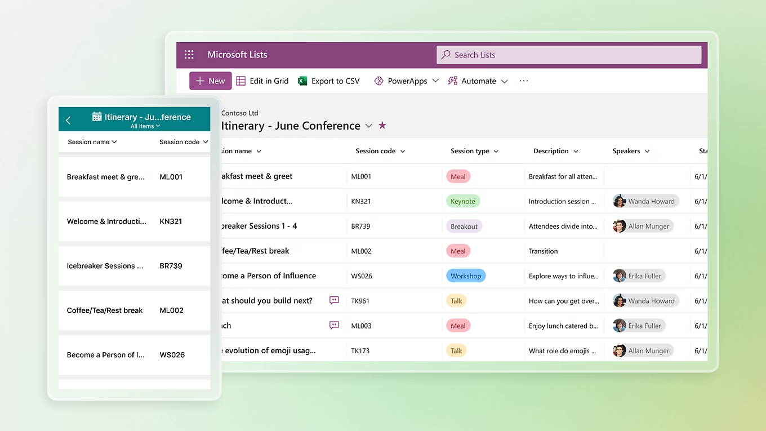
Introduction
What is Microsoft Lists
MS List is a tool for managing structured lists of data
Works like a simple table or database
Let’s users:
Create lists
View data
Manage info clearly and easily

Slide 7

Key Functionalitie

Slide 8

Key Functionalities of MS Lists
Create and Manage Lists
Custom Columns
Manage List Items
Custom Views
Conditional Formatting
Permissions and Sharing
Built-in Templates

Slide 9
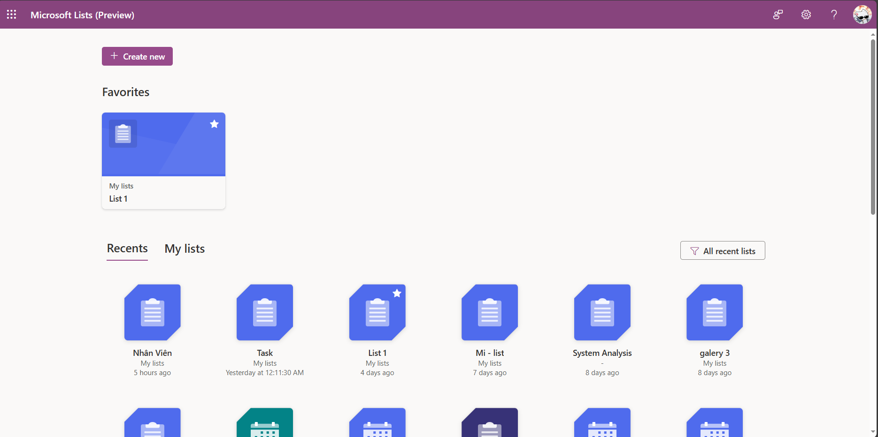
Dashboard Screen
FavoriteList
RecentList
List
ListName
WorkspaceId
Icon
Color
LastAccessedAt
Notes:
-- 1. Display all recent lists
DECLARE @UserId INT = 2;
SELECT
l.Id,
l.ListName,
l.Icon,
l.Color,
rl.LastAccessedAt,
CASE WHEN fvrl.Id IS NOT NULL THEN 1 ELSE 0 END AS IsFavorited
FROM List l
JOIN RecentList rl ON l.Id = rl.ListId
LEFT JOIN FavoriteList fvrl ON fvrl.ListId = l.Id and fvrl.FavoriteListOfUser = @UserId
WHERE rl.AccountId = @UserId
AND l.ListStatus = 'Active'
ORDER BY rl.LastAccessedAt
GO
-- 2. Display all lists that the logged-in user created
DECLARE @UserId INT = 2;
SELECT
l.ListName,
l.Icon,
l.Color
FROM List l
JOIN Workspace ws ON l.WorkspaceID = ws.Id
WHERE ws.CreatedBy = @UserId
AND l.ListStatus = 'Active'
AND ws.WorkspaceName = 'My Lists';
GO
-- 3. Display information of the logged-in user
DECLARE @UserId INT = 2;
SELECT
a.Id,
a.FirstName,
a.LastName,
a.Avatar,
a.Email,
a.Company,
a.AccountStatus
FROM Account a
WHERE a.Id = @UserId;
GO
-- 4. Display favorite lists of the logged-in user
DECLARE @UserId INT = 2; -- Replace with the ID of the logged-in user
SELECT
l.Id,
l.ListName,
l.Icon,
l.Color
FROM FavoriteList fl
INNER JOIN List l ON fl.ListId = l.Id
WHERE fl.FavoriteListOfUser = @UserId
AND l.ListStatus = 'Active'
ORDER BY fl.CreatedAt DESC;
GO

Slide 10
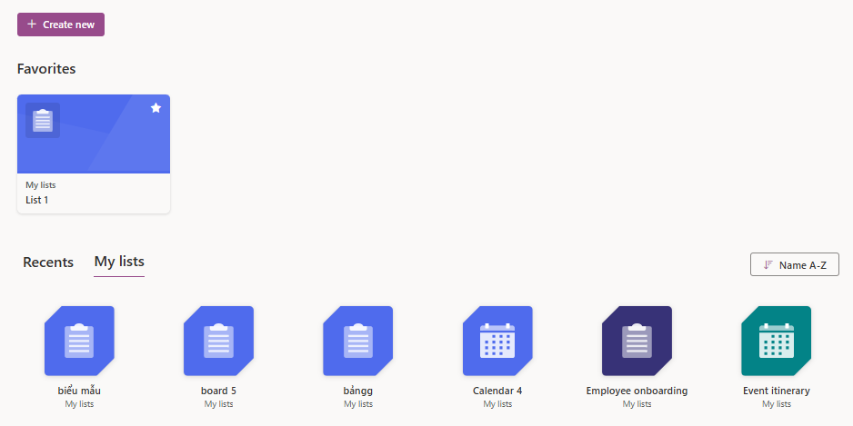
Dashboard Screen
Workspace
Workspace. WorkspaceName
Workspace. IsPersonal = true

Slide 11
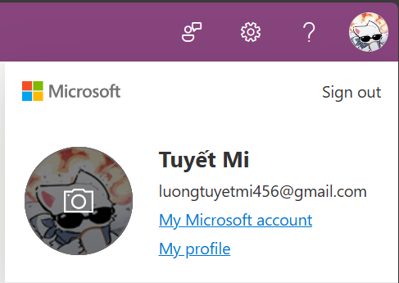
Dashboard Screen
Account
Account.FirstName
Account.LastName
Account.Avatar
Account.Email
Notes:
-- 3. Display information of the logged-in user
DECLARE @UserId INT = 2;
SELECT
a.Id,
a.FirstName,
a.LastName,
a.Avatar,
a.Email,
a.Company,
a.AccountStatus
FROM Account a
WHERE a.Id = @UserId;
GO

Slide 12
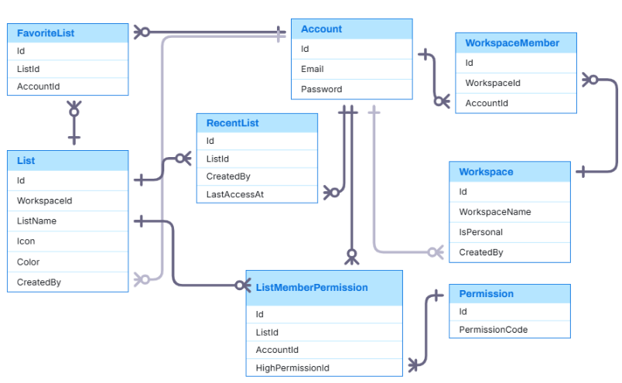
Entity Relationship

Slide 13
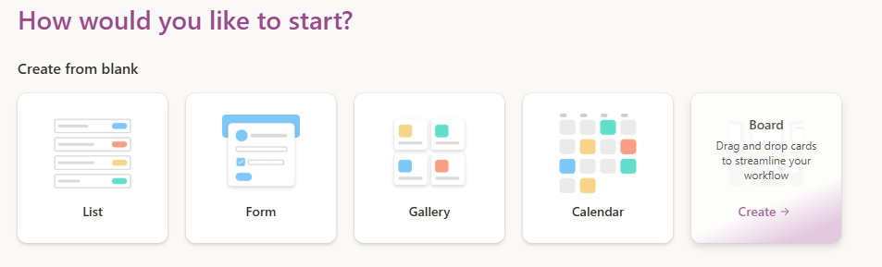
Create List Screen
ListType
ListType.Title
ListType. ListTypeDescription
ListType.HeaderImage
Notes:
-- 1. Display all list types for selection
SELECT
Title,
ListTypeDescription,
HeaderImage
FROM ListType
ORDER BY Title;

Slide 14
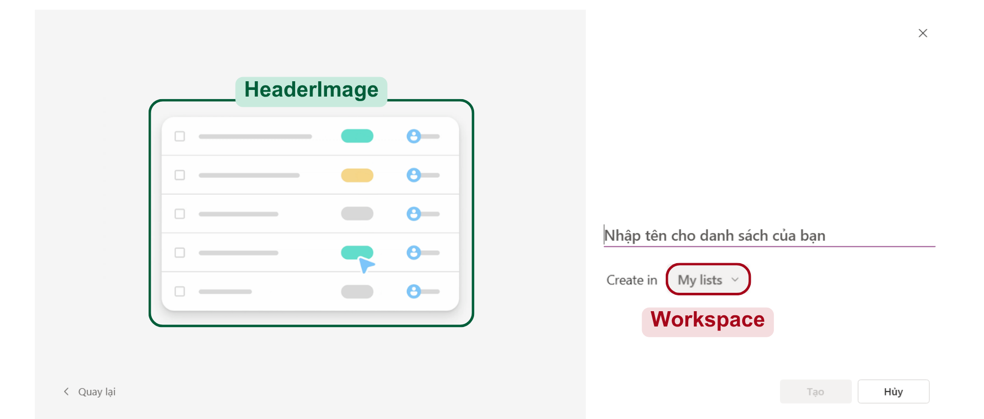
Create List From List Type
List
ListType
List.ListName

Slide 15
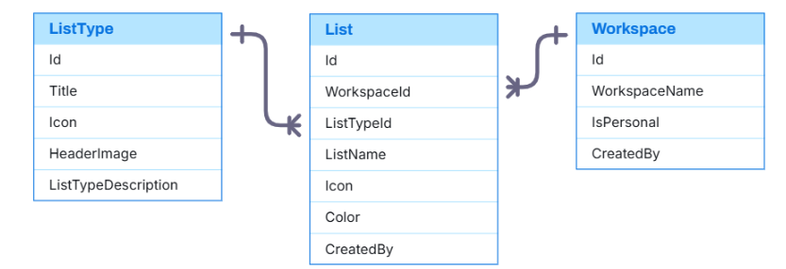
Entity Relationship

Slide 16
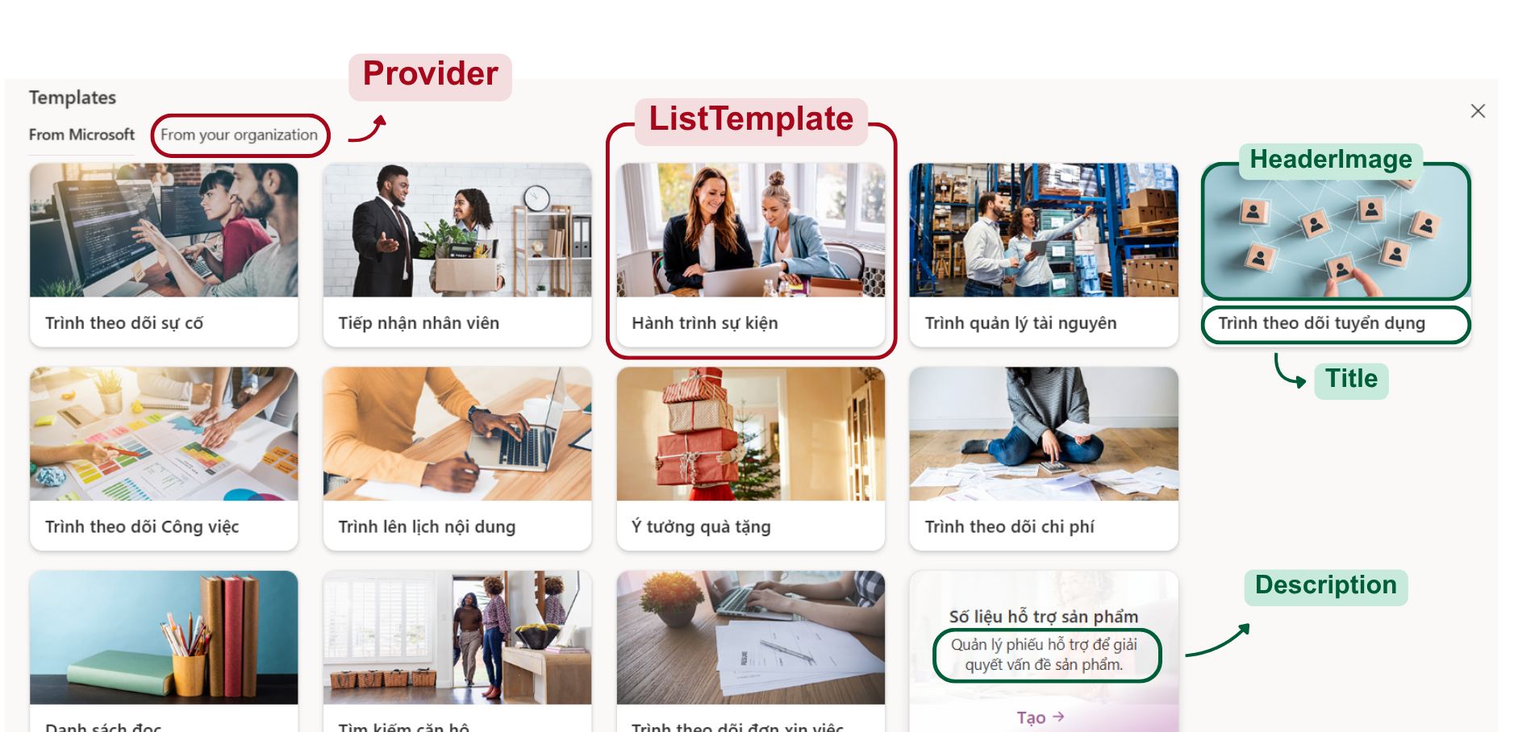
Create List Screen
Notes:
-- 2. Display all templates
SELECT
lt.Title,
lt.HeaderImage,
lt.Sumary,
pr. ProviderName
FROM ListTemplate lt
JOIN Provider pr ON lt.ProviderId = pr.Id
ORDER BY lt.Title;

Slide 17
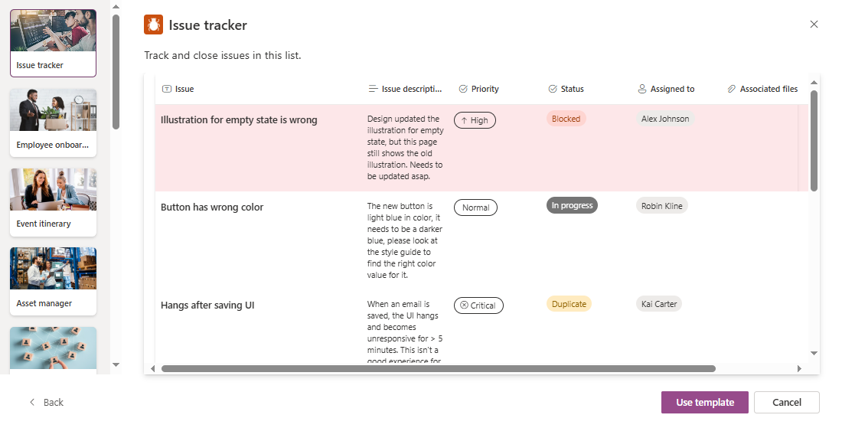
List Template
ListTemplate
ListTemplate.Icon / Color / Title
TemplateView
ListTemplate.TemplateDescription

Slide 18
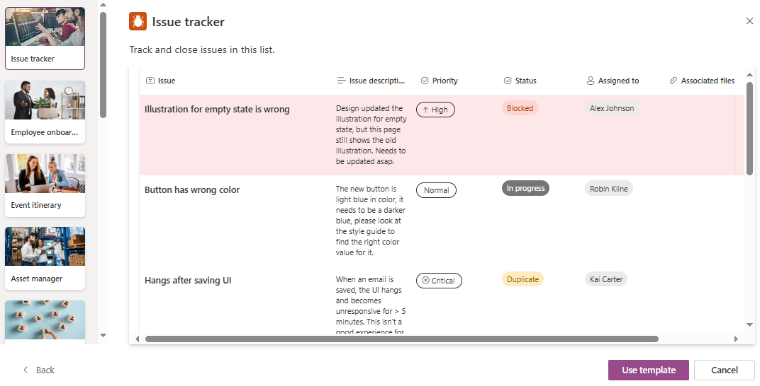
List Template
TemplateColumn
TemplateColumn. Icon / ColumnName
TemplateCellValue
TemplateRow

Slide 19
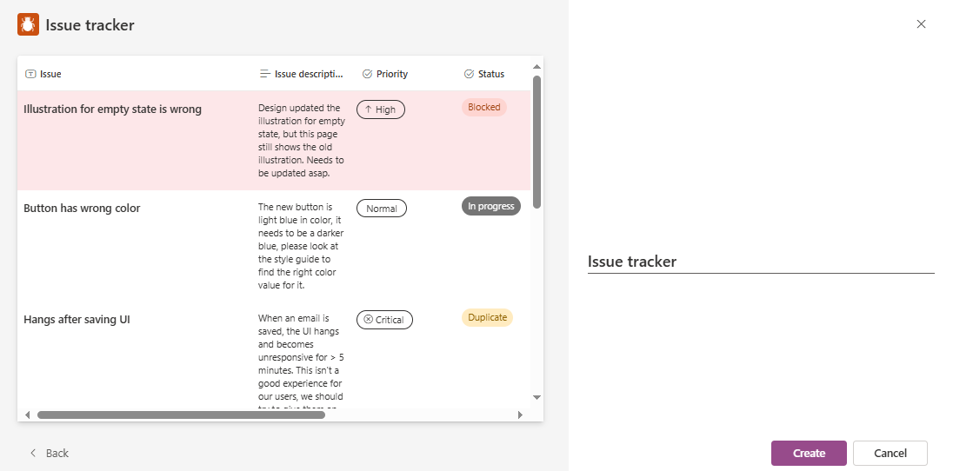
Create List from Template
List
ListTemplate
List.ListName

Slide 20
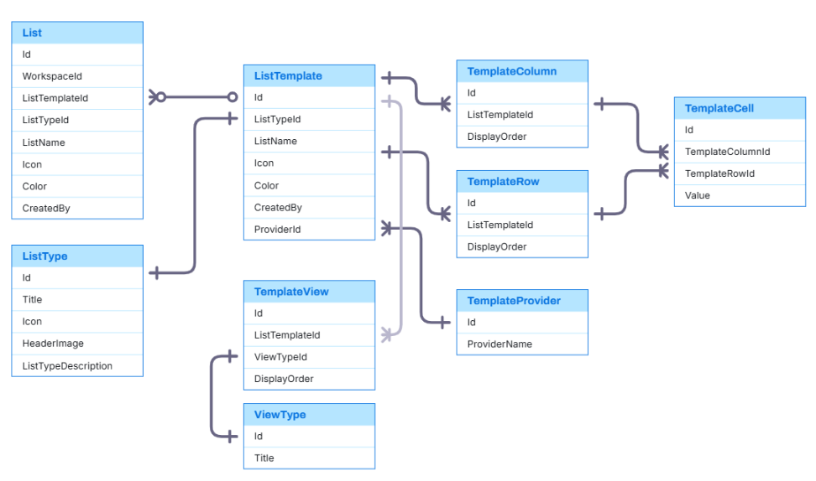
Entity Relationship

Slide 21
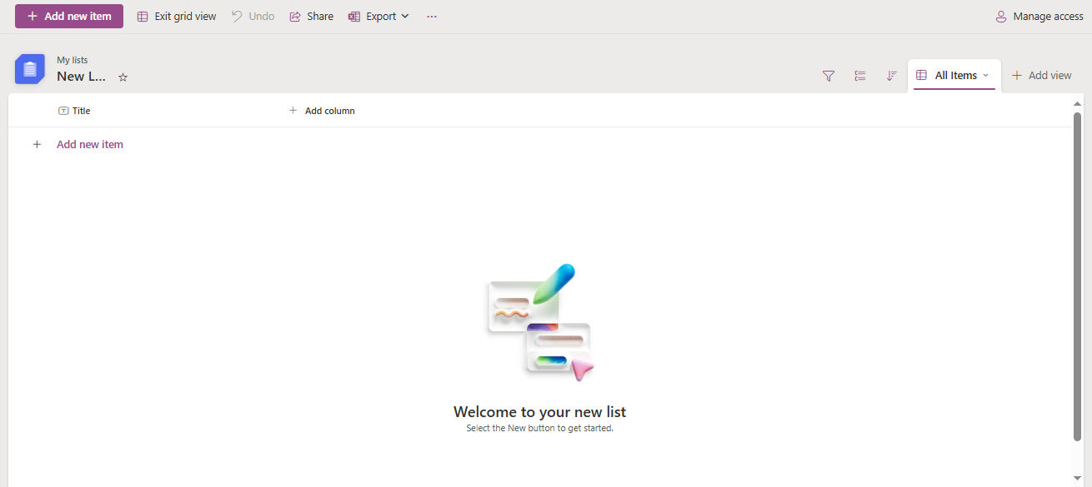
List

Slide 22
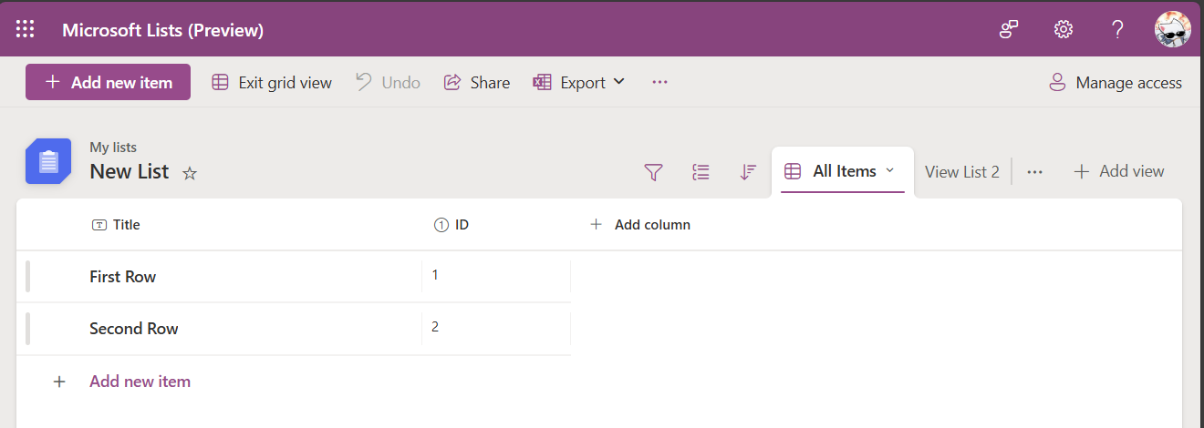
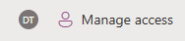
List
ListTemplate
List
ListMemberPermission
List.ListName
List.WorkspaceId
List.Color
List.Icon
FavoriteList.Listid
ListDynamicColumn
ListView
ListRow
CellValue
Notes:
-- 1. Display List information
DECLARE @UserId INT = 2;
DECLARE @ListId INT = 2;
-- Check access permission
IF EXISTS (
SELECT 1
FROM ListMemberPermission
WHERE ListId = @ListId AND AccountId = @UserId
)
BEGIN
-- User has access: show list info
SELECT
l.Id AS ListId,
l.ListName,
CASE
WHEN l.CreatedBy = @UserId THEN 'My List'
ELSE NULL
END AS Ownership,
CASE
WHEN f.Id IS NOT NULL THEN 'Yes'
ELSE 'No'
END AS IsFavorite,
'Has access' AS AccessStatus
FROM List l
LEFT JOIN FavoriteList f
ON l.Id = f.ListId AND f.FavoriteListOfUser = @UserId
WHERE l.Id = @ListId;
END
ELSE
BEGIN
-- User has no access: return notice
SELECT
NULL AS ListId,
NULL AS ListName,
NULL AS Ownership,
NULL AS IsFavorite,
'No access' AS AccessStatus;
END
GO
-- 2. Display all list views of the selected list
DECLARE @UserId INT = 2;
DECLARE @ListId INT = 2;
-- Check if the user has access
IF EXISTS (
SELECT 1
FROM ListMemberPermission
WHERE ListId = @ListId AND AccountId = @UserId
)
BEGIN
-- User has access: show all views of the list
SELECT
lv.Id,
lv.ListId,
lv.ViewName,
lv.DisplayOrder
FROM ListView lv
WHERE lv.ListId = @ListId
ORDER BY lv.DisplayOrder;
END
ELSE
BEGIN
-- User has no access
SELECT
NULL AS ListViewId,
NULL AS ViewName,
NULL AS ViewType,
NULL AS DisplayOrder,
NULL AS IsDefault,
NULL AS CreatedAt,
'No access to this list' AS AccessStatus;
END
GO
-- 3. Display visible Dynamic Columns
DECLARE @ListId INT = 2;
SELECT
sd.Icon,
dc.ColumnName,
dc.IsVisible,
dc.DisplayOrder
FROM ListDynamicColumn dc
JOIN SystemDataType sd ON dc.SystemDataTypeId = sd.Id
WHERE dc.ListId = @ListId
AND dc.IsVisible = 1
ORDER BY dc.DisplayOrder;
GO
-- 4. Display all Dynamic Columns
DECLARE @ListId INT = 2;
SELECT
dc.ColumnName,
dc.IsVisible,
dc.DisplayOrder
FROM ListDynamicColumn dc
WHERE dc.ListId = @ListId
ORDER BY dc.DisplayOrder;
GO
-- 5. Display avatars of users with access to the list
DECLARE @ListId INT = 2;
SELECT
a.Avatar,
a.FirstName
FROM ListMemberPermission lmp
JOIN Account A on lmp.AccountId = a.Id
WHERE lmp.ListId = @ListId
GO DECLARE @ListId INT = 1; -- Change to desired ListId
DECLARE @Columns NVARCHAR(4000) = ''; -- Column < 100
DECLARE @SQL NVARCHAR(4000) = '';
-- Build column list dynamically
SELECT @Columns = STRING_AGG(QUOTENAME(ColumnName), ', ')
FROM ListDynamicColumn
WHERE ListId = @ListId;
-- Construct the dynamic SQL
SET @SQL = '
SELECT *
FROM (
SELECT
lr.Id AS RowId,
lr.DisplayOrder AS RowOrder,
ldc.ColumnName,
lcv.CellValue
FROM ListRow lr
CROSS JOIN ListDynamicColumn ldc
LEFT JOIN ListCellValue lcv ON lcv.ListRowId = lr.Id AND lcv.ListColumnId = ldc.Id
WHERE lr.ListId = @ListId
) AS SourceTable
PIVOT (
MAX(CellValue)
FOR ColumnName IN (' + @Columns + ')
) AS PivotTable
ORDER BY RowOrder;';
-- Execute the dynamic SQL
EXEC sp_executesql @SQL, N'@ListId INT', @ListId;
GO

Slide 23
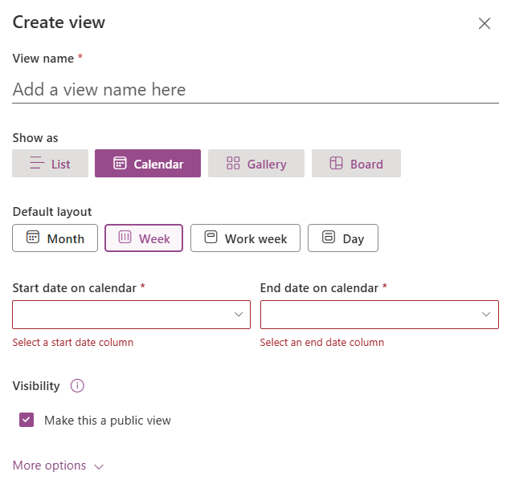
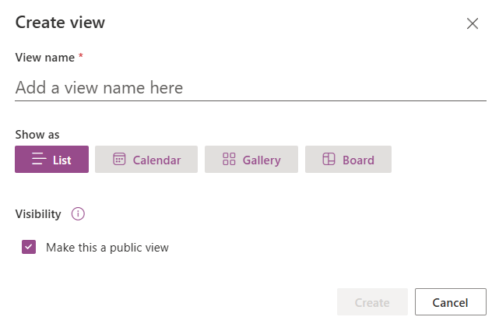
Create View
ListView
ViewType
KeySetting
KeySetting.KeyName
KeySetting.ValueType
(e.x: Text. Number, Boolean,…)

Slide 24
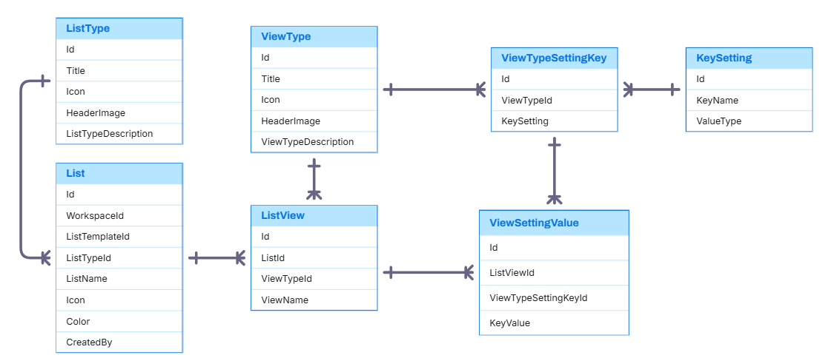
Entity Relationship

Slide 25
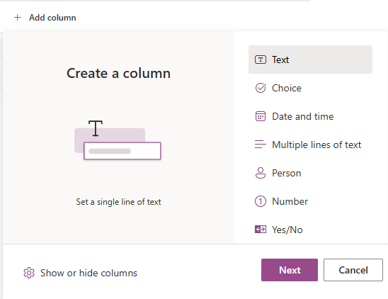
Dynamic Column
SystemDataType
SystemDataType.Icon
SystemDataType. DisplayName
SystemDataType.CoverImg
SystemDataType.DataDiscription
ListDynamicColumn
Notes:
-- 1. Display all Data Types of the Column.
SELECT
sd.CoverImg,
sd.DataTypeDescription,
sd.Icon,
sd.DisplayName
FROM SystemDataType sd
GO

Slide 26
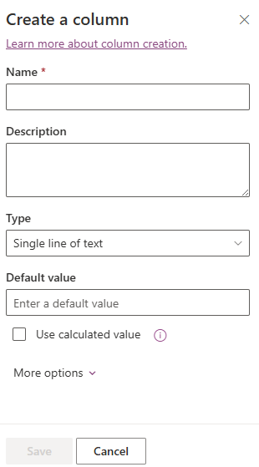
Create Dynamic Column
ListDynamicColumn
n
ListDynamicColumn.ColumnName
ListDynamicColumn.ColumnDescription
1
SystemDataType

Slide 27
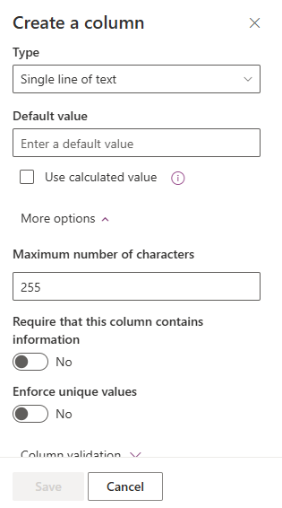
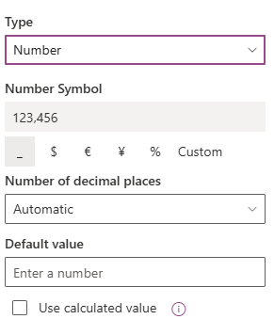
Create Dynamic Column
ListDynamicColumn
SystemDataType
1
n
DataSettingKey
n
1
KeySetting
KeySetting.KeyName
KeySetting.ValueType (e.x: Text. Number, Boolean,…)

Slide 28
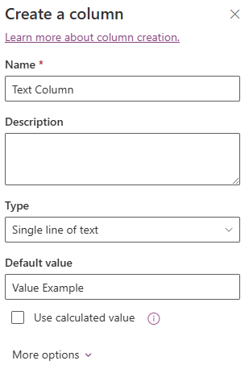
DataTypeSettingKey
ListDynamicColumn
DataSettingKey.SystemDataType
DataSettingKey.KeySetting
DataSettingKey
DynamicColumnSettingValue. KeyValue
Notes:
-- 2. Display Key Settings corresponding to that Data Type.
DECLARE @SystemDataTypeId INT = 1;
SELECT
sd.DisplayName,
ks.KeyName,
ks.ValueType
FROM KeySetting ks
JOIN DataTypeSettingKey dsk ON ks.Id = dsk.KeySettingId
JOIN SystemDataType sd ON dsk.SystemDataTypeId = sd.Id
WHERE dsk.SystemDataTypeId = @SystemDataTypeId
GO

Slide 29
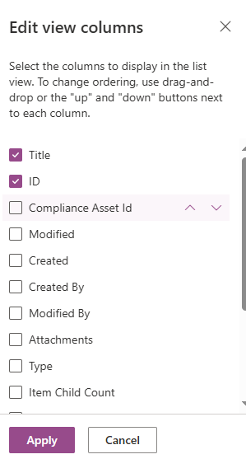
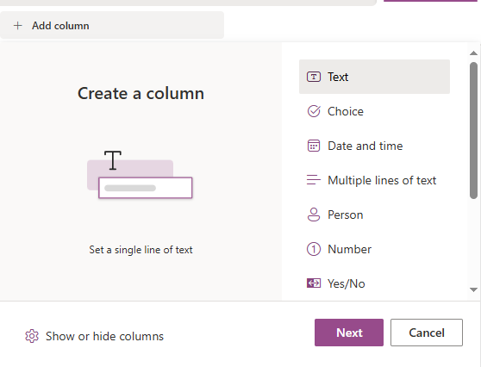
SystemColumn
Each list will have default columns based on system columns, and these columns can be hidden depending on the view.
ListViewColumn
ListDynamicColumn.Name
ListViewColumn.IsVisible
ListViewColumn. DisplayOrder

Slide 30
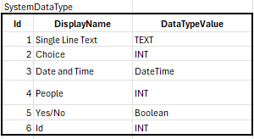
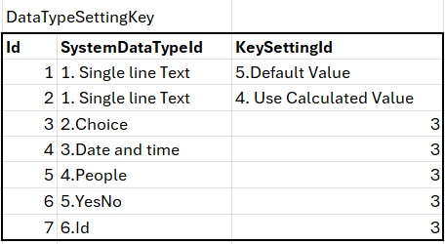
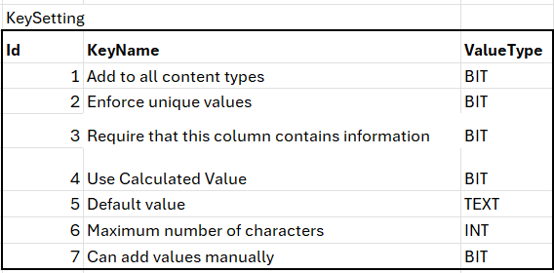
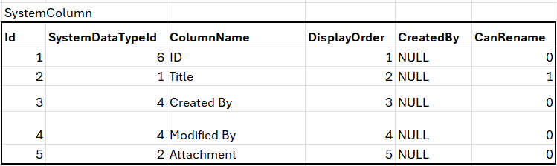
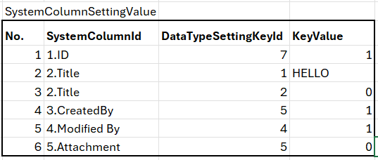
Example Data

Slide 31
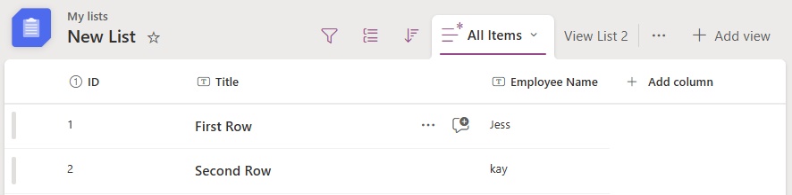
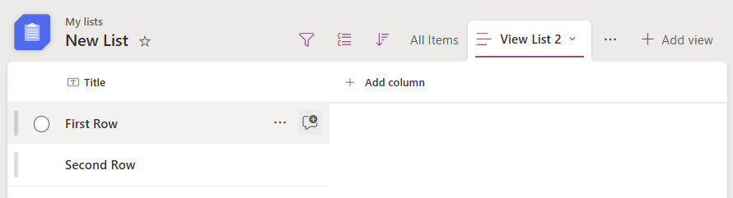
Flexible Column Display
View “All Items”
Each view can customize which columns are visible and their order.
1
2
3
View “View List 2”
1

Slide 32
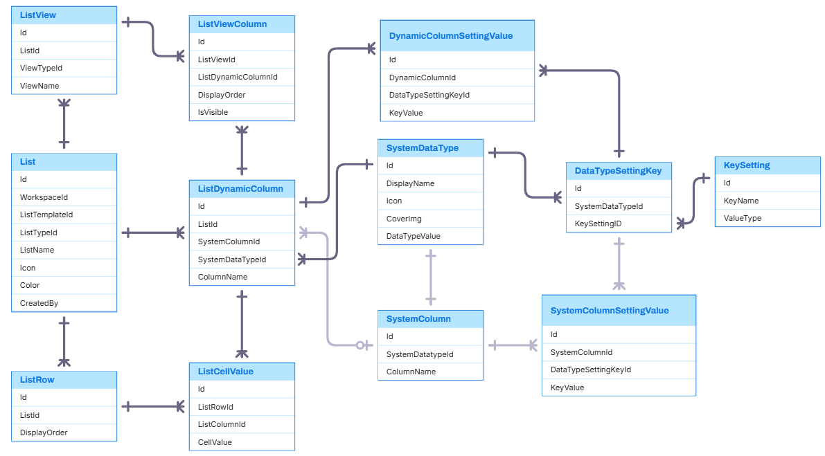
Entity Relationship

Slide 33
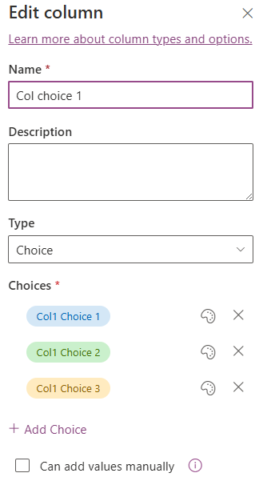
SystemDataType
SystemDataType
ListColumnChoice
ListColumnChoice.ChoiceValue
ListColumnChoice.Color
ListColumnChoice.DisplayOrder

Slide 34
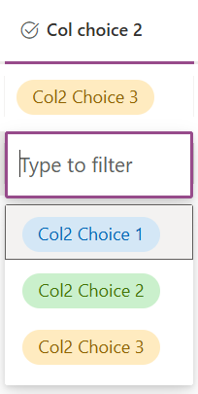
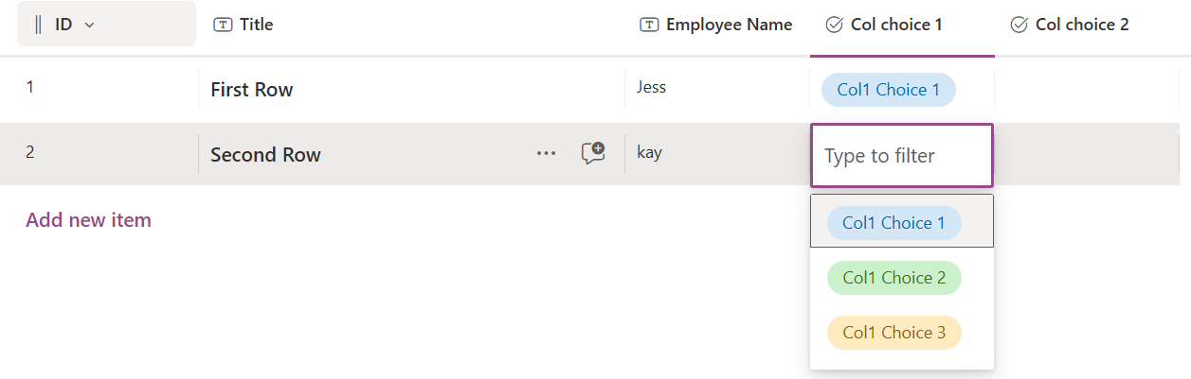
SystemDataType
ListDynamicColumn.Id = 2
ListDynamicColumn.Id = 1
ListColumnChoice
=> Each choice belongs to exactly one ListDynamicColumn (Id).

Slide 35
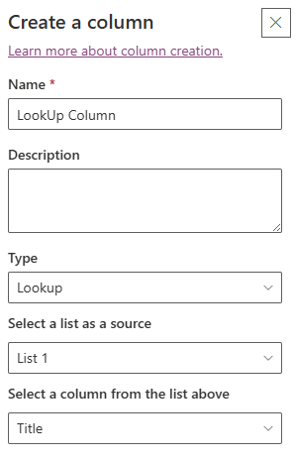
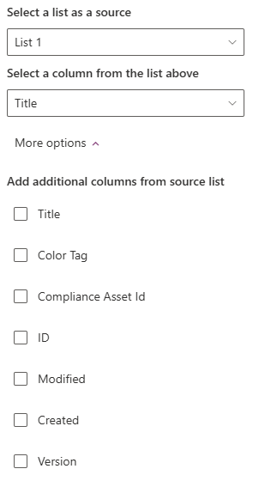
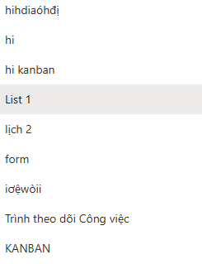
SystemDataType
ListDynamicColumn
List
ListDynamicColumn.ListId
ListId
ListDynamicColumn.ListId

Slide 36
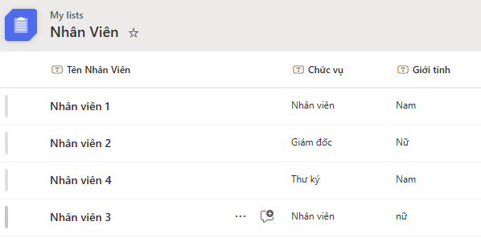
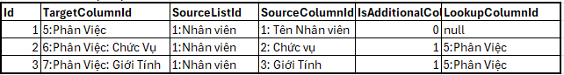
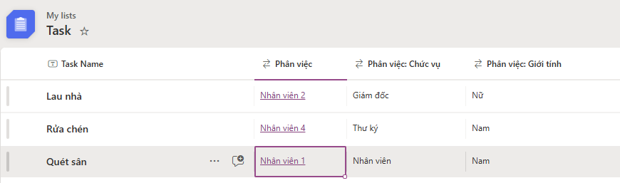
ListColumnLookUpMap
SourceList
SourceColumn
ListColumnLookUpMap example data
TargetColumn
ListColumnLookUpMap.IsAdditionalColumn = true

Slide 37
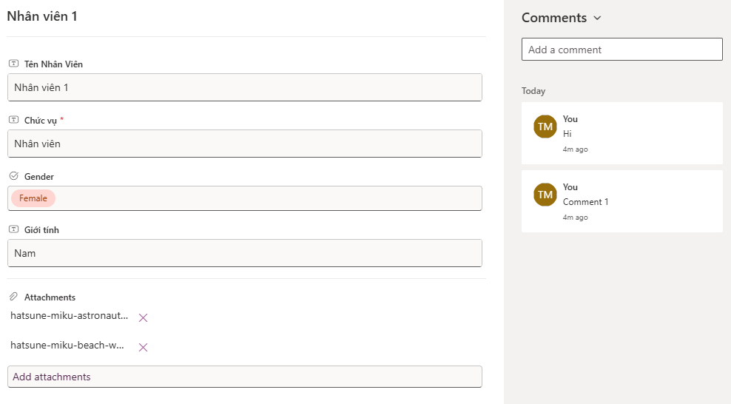
ListRow
ListRow
ListDynamicColumn.Icon / Column Name
ListCellValue.CellValue
Account
ListRowComment
ListRowComment.Content
ListRowComment.CreatedAt
ListRowComment.CreatedBy
FileAttachment
ListDynamicColumn
Notes:
-- 1. Display the cell values for each column of the specified list row
DECLARE @ListId INT = 1;
DECLARE @ListRow INT = 1;
SELECT
ldc.ColumnName,
lcv.CellValue
FROM ListCellValue lcv
JOIN ListDynamicColumn ldc ON lcv.ListColumnId = ldc.Id
JOIN ListRow lr ON lcv.ListRowId = lr.Id
WHERE lr.Id = @ListRow
AND lr.ListId = @ListId -- đảm bảo đúng row thuộc list đó
AND ldc.ListId = @ListId -- chỉ lấy cột của list này
ORDER BY ldc.DisplayOrder;
GO
--select
--*
--from ListMemberPermission
--where ListId = 2
-- 2. Display the comments associated with that list row
DECLARE @ListId INT = 1;
DECLARE @ListRow INT = 1;
SELECT
a.FirstName,
a.Avatar,
lrc.Content,
lrc.CreatedAt
FROM ListRowComment lrc
JOIN Account a ON lrc.CreatedBy = a.Id
WHERE lrc.ListRowId = @ListRow

Slide 38
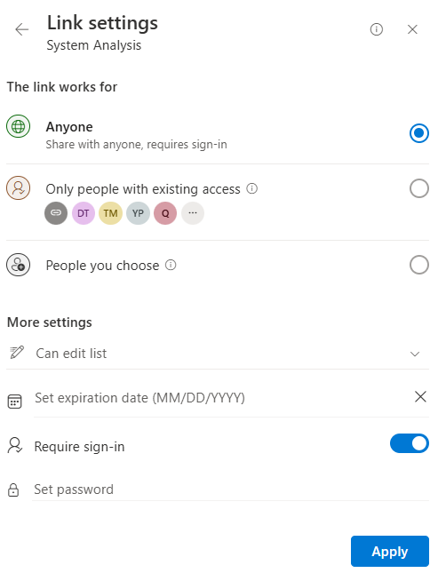
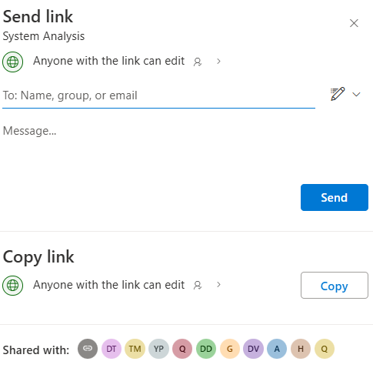
Create ShareLink
ShareLinkUserAccess
Scope.Icon /DisplayName
/ScopeDescription
Scope
ListPermission
ListPermission.Icon /PermissionName
ListMemberPermission

Slide 39
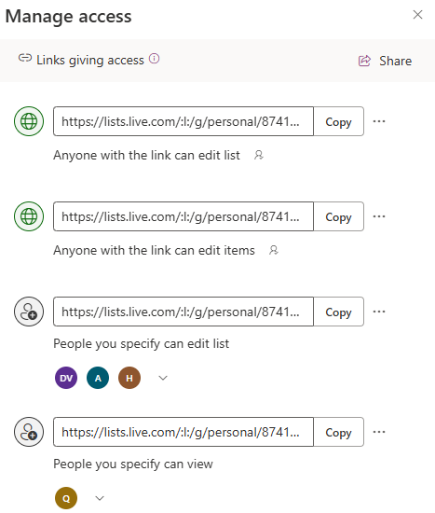
ShareLink
ShareLink
ShareLink.ScopeId
ShareLink.TargetUrl
ShareLink. PermissionId
ShareLinkUserAccess

Slide 40
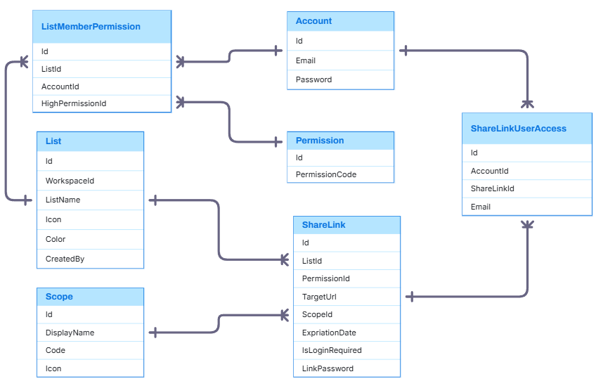
Entity Relationship

Slide 41
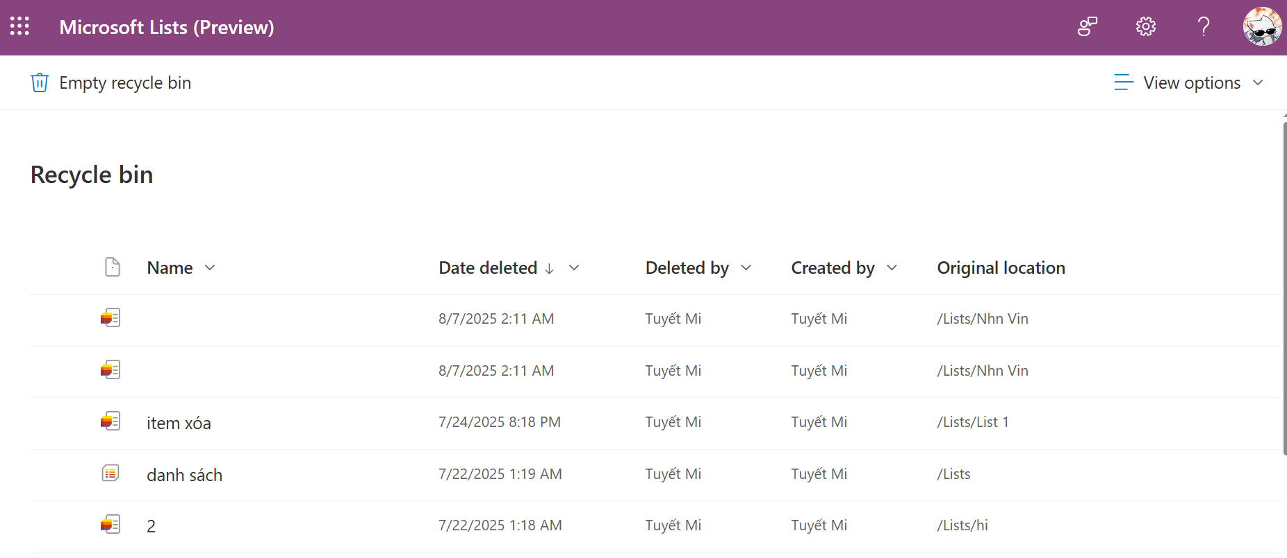
Trash
Trash
Icon
DateDateted
Account
EntityId
EntityType

Slide 42
Unit Test

Slide 44
Q&A

